Slide 1


JavaScript App Platform

Slide 2
What We’ll Cover
What is Meteor?
Why Meteor?
Demo

Slide 3
What is Meteor?
Full-stack JavaScript open source platform
Web and mobile apps
100% JavaScript, frontend and backend

Slide 4
Meteor Tools
CLI Tool – meteor – create, run, deploy
Full stack package systems – atmosphere and npm
Build system – browser and mobile (Cordova)

Slide 5
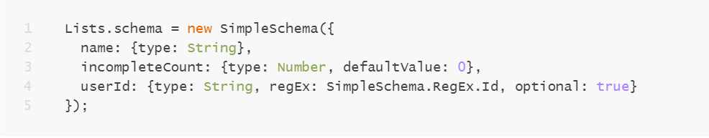
Meteor components - Collections
Server and client-side Mongo Collections – Minimongo on the client (oplog based LiveQuery system)
JSON schema

Slide 6
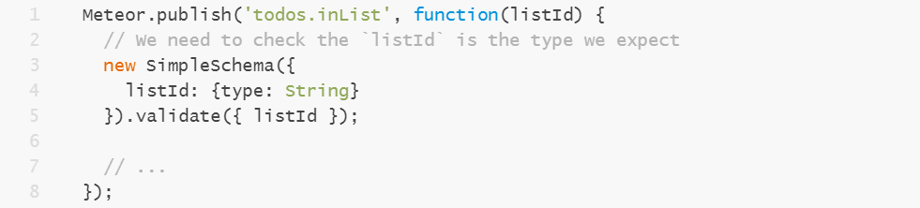
Meteor components – Pub/Sub
Publications (server APIs)
Subscriptions (data connections) using DDP or REST – bridge between server and client collections

Slide 7
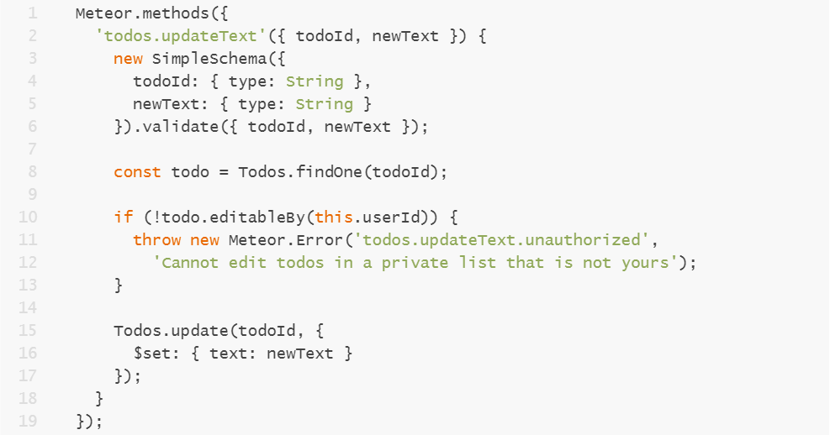
Meteor components – Server Methods
Server methods (server APIs / RPC) - synchronous, non-blocking, sequential

Slide 8
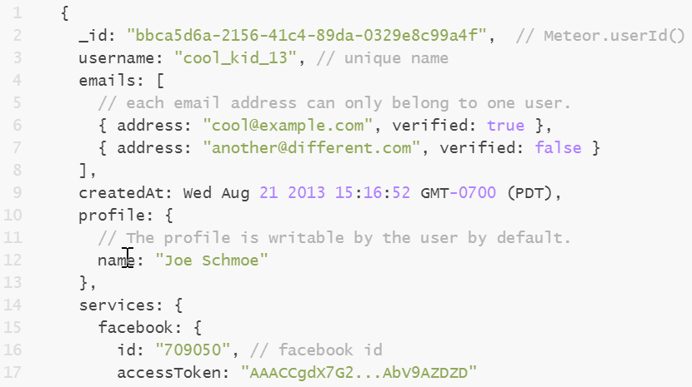
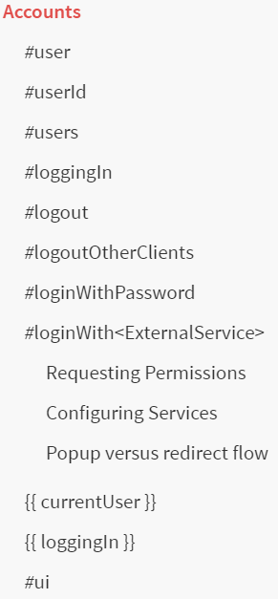
Meteor components - Accounts
Users and accounts (Oauth, email, roles)

Slide 9
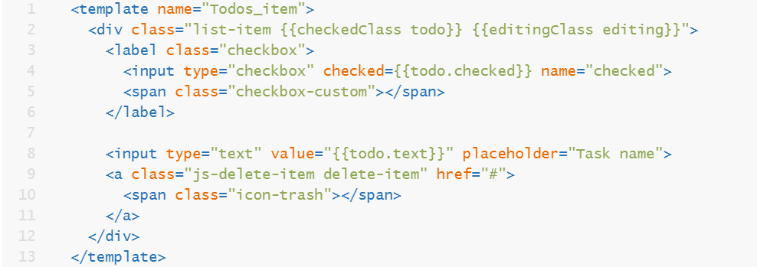
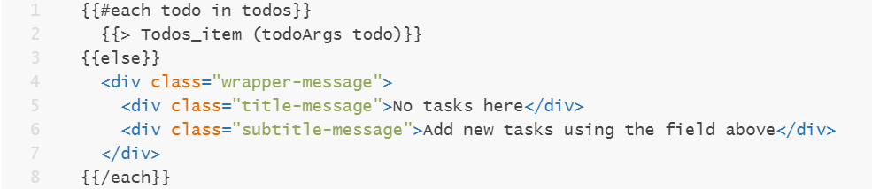
Meteor components - Views
UI rendering libraries: Blaze (Handlebars)

Slide 10
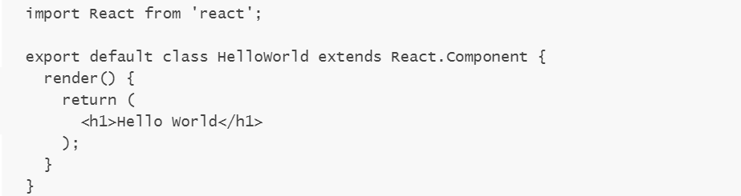
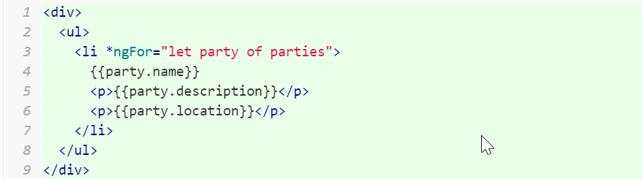
Meteor components - Views
React (JSX)
Angular (HTML with special attribute syntax)

Slide 11
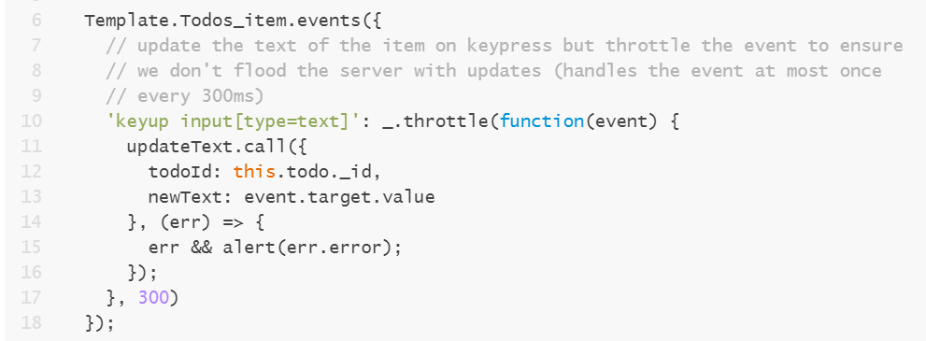
Meteor components - View
UI/UX patterns: Event handling, Subscription readiness, Pagination, Optimistic UI
Reusable components: Iteration, Helpers, Reactive variables

Slide 12
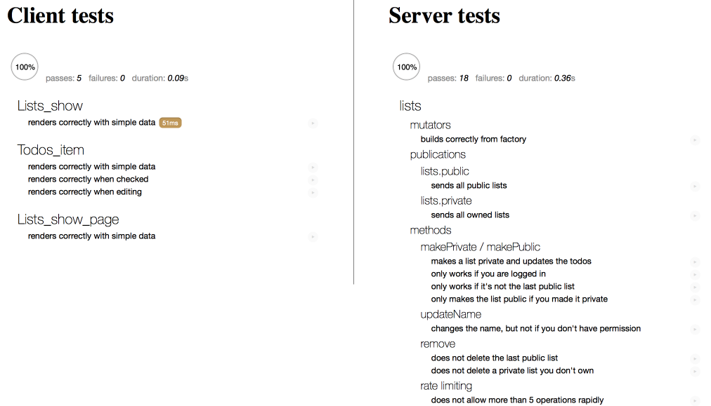
Meteor components - Testing
Testing – “meteor test”
Unit (mocha), Integration (mocha), Acceptance (chimp), in CI (mocha-phantomjs)

Slide 13
Meteor Platform
PLATFORM
Web
Mobile
App Components & Logic
Blaze
React
Angular
Client Data Cache
CLIENT
DDP
SERVER
Livequery
App Microservices
SOURCES
MongoDB
SQL
REST

Slide 14
Meteor - Build
Packages:
Atmosphere (native)
Npm
Cordova
Build System
Reloads app on file change
Compiles, combines and minifies code
Hot code push

Slide 15
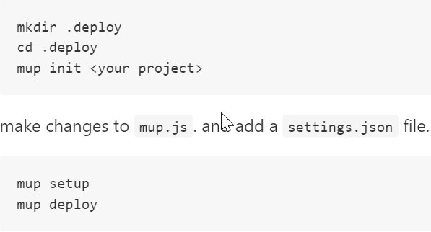
Meteor - Production
Deployment and Monitoring
meteor build (noje.js app)
analytics
meteor-up tool

Slide 16
Meteor - Production
Security:
Collection client access rules
Method validation
Rate limiting
meteor deploy myapp.com --settings production.json

Slide 17
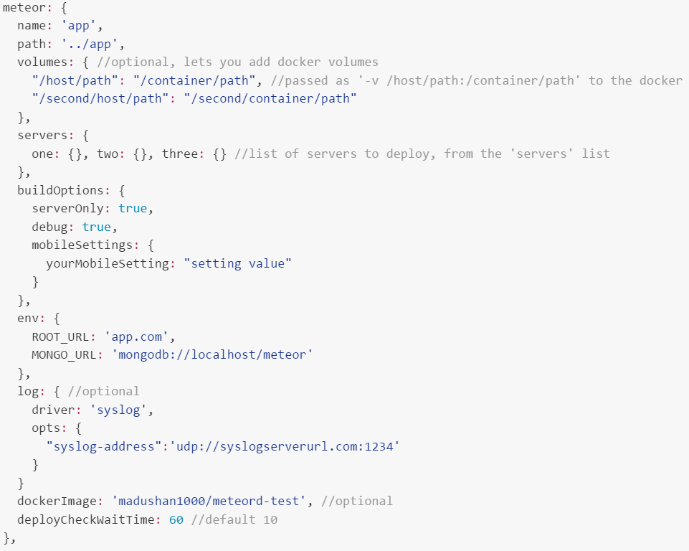
Meteor - Production
meteor-up

Slide 18
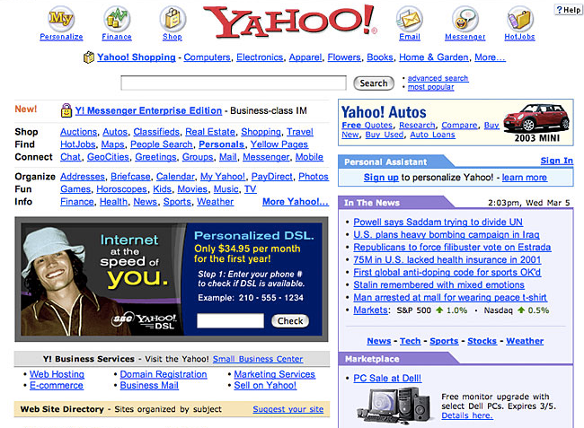
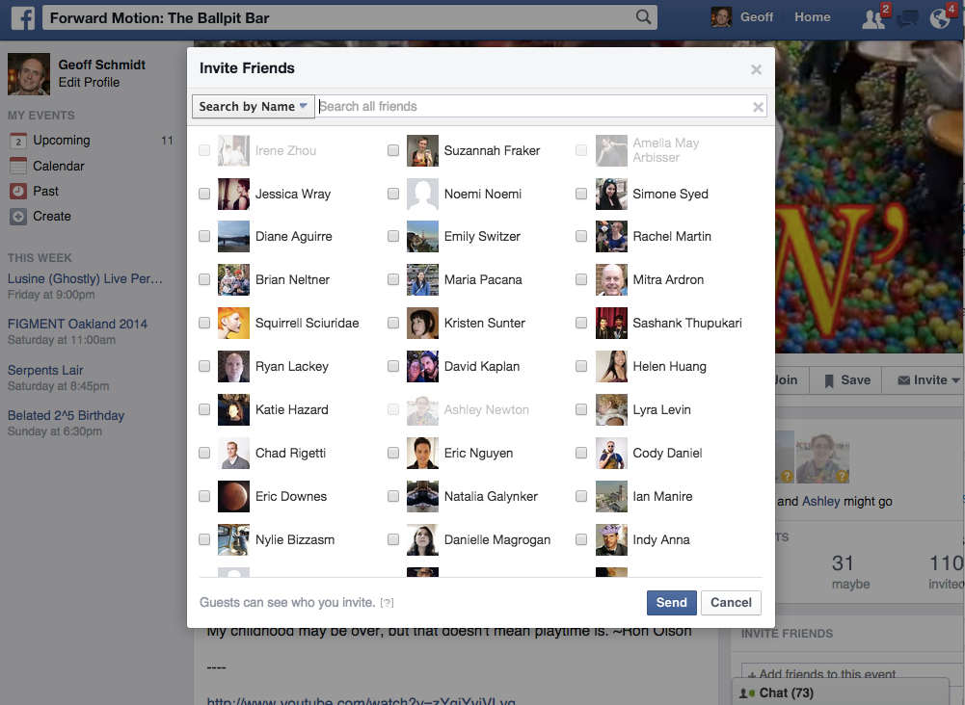

Why Meteor?
Then
Browser
Refresh button
Individual sessions
Links and forms
Now
Browser and Mobile
Live updates
Multiuser collaboration
Native-style GUI

Slide 19



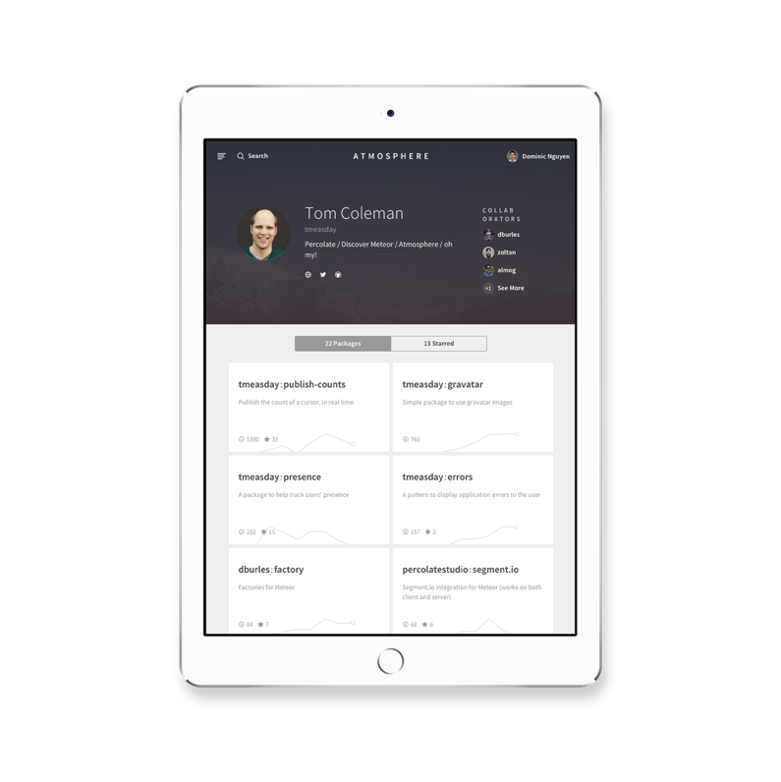


Cool Stuff
Optimistic UI
Minimongo
Messages.insert()
Messages.insert()

Slide 20
Cool Stuff
Full-stack packages
Reactive rendering
Database sync
Intuitive, isomorphic API (client and server shared code)
Minimal boilerplate code
Fast install to deploy
Hot code push
Multi-platform support

Slide 21
Learning Meteor
meteor.com/tutorials
guide.meteor.com
themeteorchef.com
github.com/Urigo/awesome-meteor

Slide 22
Thank You!

Slide 23
Demo
Medtech

